Slide 1

UI component tags

Slide 2
UI component tags
Why we need UI component tags
More than just form elements
GENERATING THE HTML MARKUP
BINDING FORM FIELDS TO VALUESTACK PROPERTIES
INTEGRATION WITH TYPE CONVERSION, VALIDATION, AND INTERNATIONALIZATION
Tags, templates, and themes
Tags
Teamplates
Themes
CHANGING THE THEME

Slide 3
UI component tags
UI Component tag reference
Common attributes
Simple components
THE HEAD COMPONENT
THE FORM COMPONENT
THE TEXTFIELD COMPONENT
THE PASSWORD COMPONENT
THE TEXTAREA COMPONENT
THE CHECKBOX COMPONENT
Collection-backed components
THE SELECT COMPONENT
THE RADIO COMPONENT
THE CHECKBOXLIST COMPONENT
PREPOPULATION WITH COLLECTION-BACKED COMPONENTS

Slide 4
UI component tags
Bonus components
THE LABEL COMPONENT
THE HIDDEN COMPONENT
THE DOUBLESELECT COMPONENT
Summary

Slide 5
Why we need UI component tags
■ Generate HTML markup ■ Bind HTML form fields to Java-side properties ■ Tie into framework type conversion ■ Tie into framework validation ■ Tie into framework internationalization

Slide 6
Why we need UI component tags
GENERATING THE HTML MARKUP
Struts 2
<s:textfield name="username" label="Username"/>
HTML
<td class="tdLabel"> <label for="Register_username" class="label">Username:</label> </td> <td> <input type="text" name="username" value="" id="Register_username"/> </td>

Slide 7
Why we need UI component tags
The Struts 2 UI component tags were carefully designed as a mini-MVC UI component framework of their own.
FreeMarker template that can easily be edited.
Can tweak the Struts 2 UI components to generate HTML that meets your own idiosyncratic requirements.

Slide 8
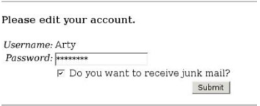
Why we need UI component tags
BINDING FORM FIELDS TO VALUESTACK PROPERTIES
The account form is prepopulated with data from properties on the ValueStack

Slide 9
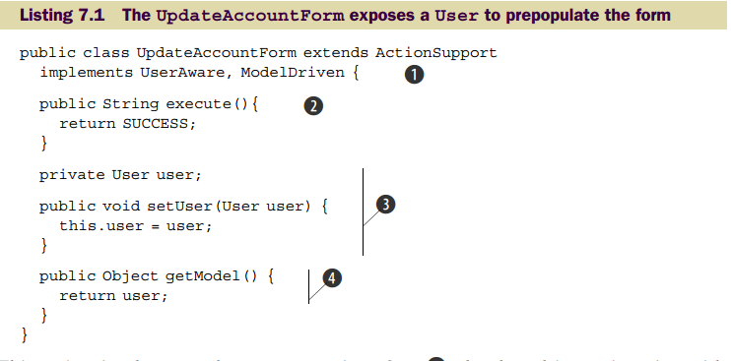
Why we need UI component tags
This binding lays the foundation for a bidirectional flow of data between UI components and the domain model objects on the ValueStack
we’ll expose our User object as a
domain model object rather than as a local JavaBeans property

Slide 10
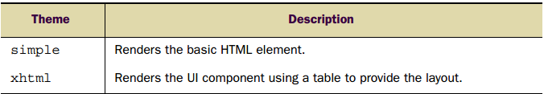
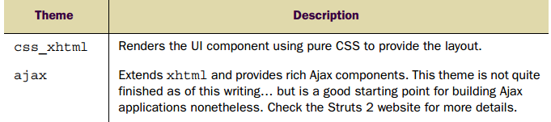
Theme

Slide 11
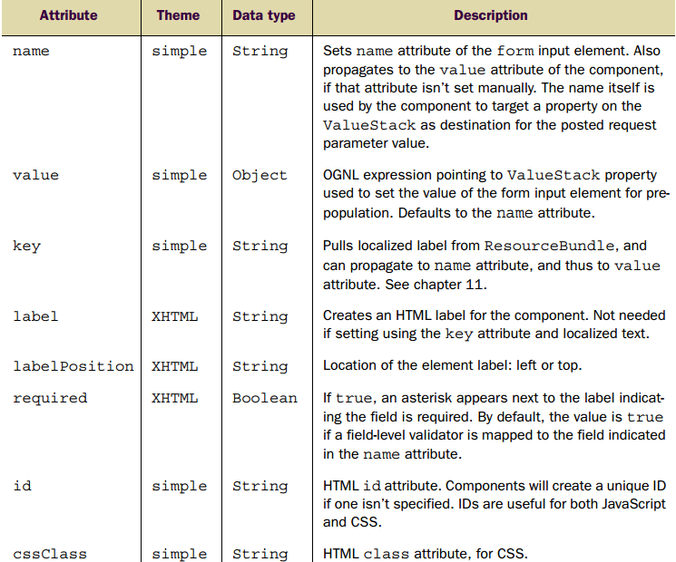
Common attributes

Slide 12
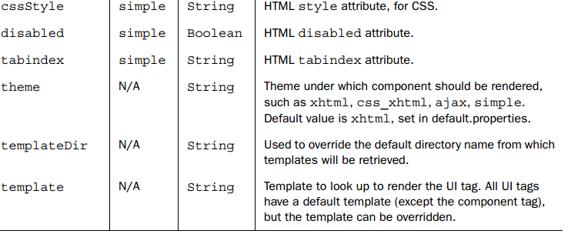
Common attributes

